Slide 1

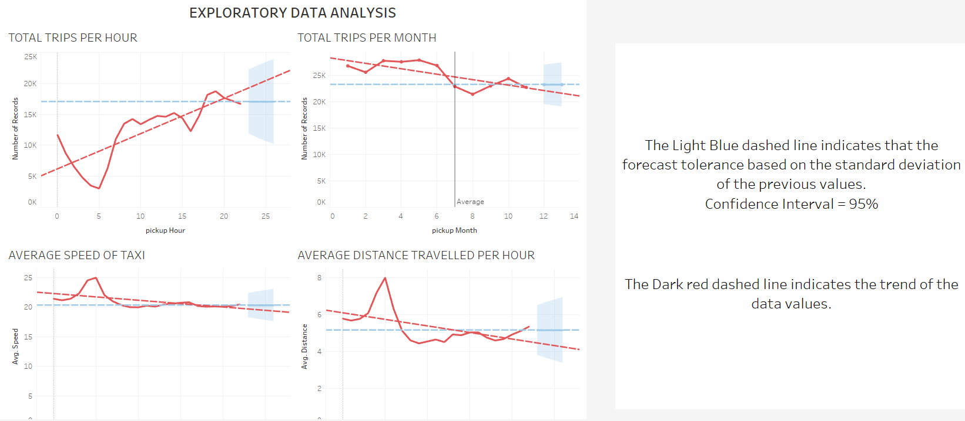
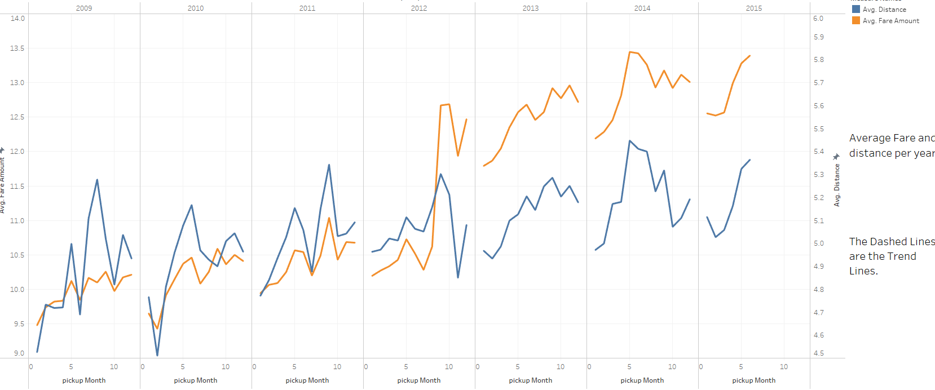
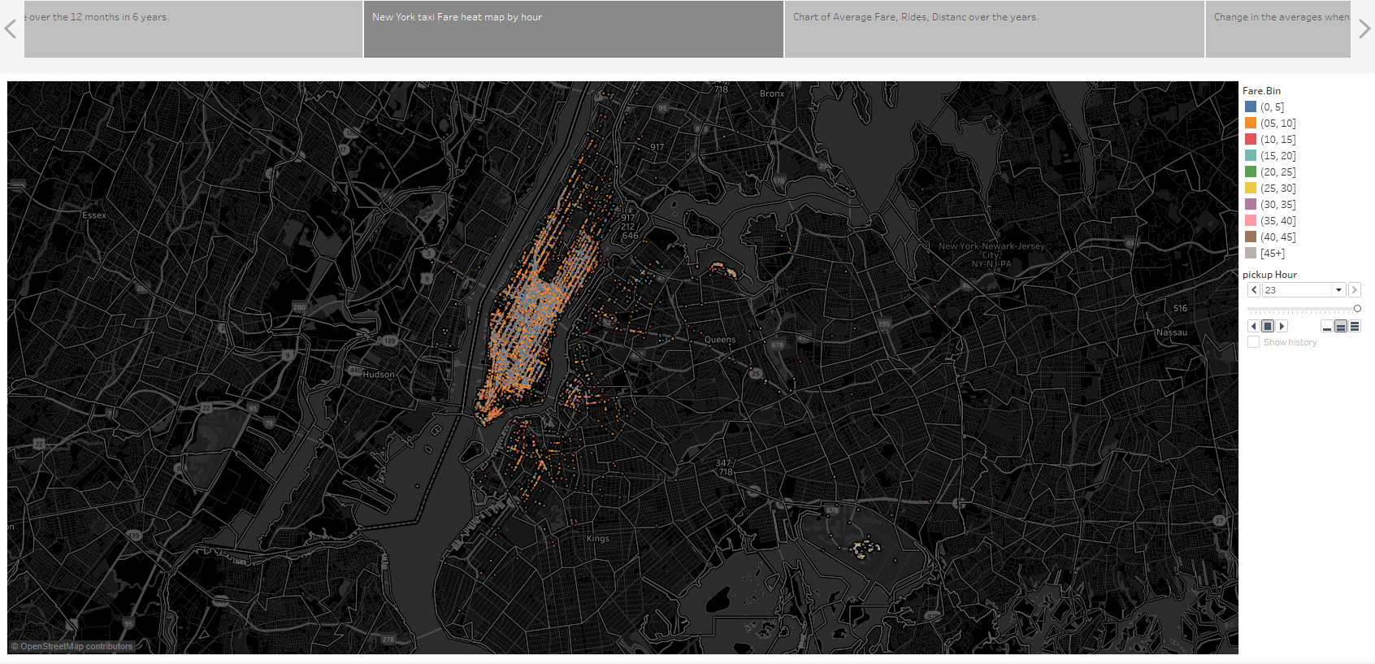
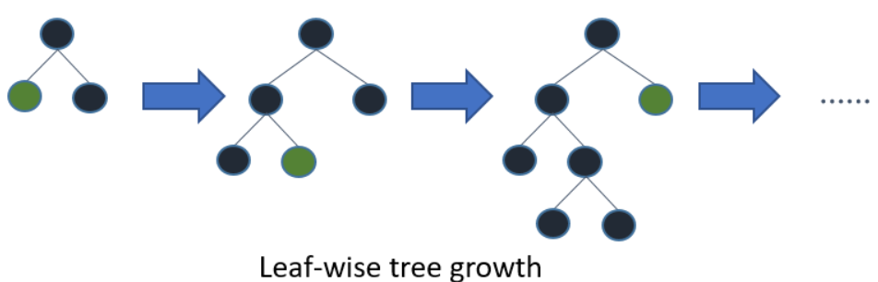
HOT WHEELS @ NYC TAXI
Abhitej Kodali, Nikhil Lohiya
Instructor: Prof. Alkis Vazacopoulus
Business Intelligence & Analytics
INTRODUCTION
OBJECTIVE
It is a large dataset about the New York City Taxi Fare (Approx. 55 Million Rows) containing information on pick up / drop off points, time, date, fare, etc. The idea is to explore the visualizations on a large-scale data with Tableau and further write a prediction algorithm for the testing dataset.
BACKGROUND
New York City is US’ largest Metropolitan area with population of 20.1 million.
In the last year, there were 302,599 licenses issued to the drivers, where as the budget amounted to $46,890,009.
Such a large market tells a lot about the taxi requirements, patterns, and fares which are not only useful for the customers but also potential market entrants.
DATA VISUALIZATIONS
Exploratory - Analysis
Changes in Price over 12 Months in 6 years
New York City Heat Map by hour
PREDICTION MODELLING
Calculated Fare build up using NY Taxi fare, to account for additional fare due to surcharge and discount rates available
Divided by datetime to categorical timeframe to account the change in values to date time observation and convert time-series data to a normal dataset to apply Machine Learning Models
LightGBM (Introduction) - LightGBM is a gradient boosting framework that uses tree-based learning algorithms. It is designed to be distributed and efficient with the following advantages:
i. Faster training speed and higher efficiency.
ii. Lower memory usage.
iii. Better accuracy.
iv. Support of parallel and GPU learning.
v. Capable of handling large-scale data.
Leaf-wise may cause over-fitting when data is small, so LightGBM includes the max_depth parameter to limit tree depth. However, trees still grow leaf-wise even when max_depth is specified.
Achieved RMSE of 3.06$ and ranked 311 out of 1488 teams.
CONCLUSION
Base Fare increased in the mid 2012, where the average fare per ride increase exponentially, because of Uber and Lyft being the new market entrants.
Yellow Taxis on an average charged approximately 5$ per mile distance covered in New York.
The lowest ride fares are observed during early morning time frame approximately between 3 a.m. to 5 a.m.
Future scope would be to bring in data from Uber and Lyft to analyze the rise of taxi ride sharing in New York City and the affect on the prices.
http://www.stevens.edu/bia

